Slide 1
Intro Slide

Slide 2
What is Generative Artificial Intelligence (AI)?
Technology that uses algorithms and machine learning to create new content (text, photos, video, audio, etc.)
Examples of AI software*:
  ChatGPT/OpenAI
  Socratic
  AirMath
  Nerdy Bot
  Grammarly
  OddityAI
* Not all inclusive

Slide 3
Dangers of AI Use in Academics
AI software often has errors/inaccuracies
Use of AI to complete or assist with assignments may impede true comprehension of course concepts
AI software may retain uploaded content and use it in the future without your acknowledgment or awareness
In general, unauthorized use of generative AI to complete academic work is considered Academic Misconduct.
  See LSU Code of Student Conduct Section 10.1 Misrepresentation and 10.1 Unauthorized Materials

Slide 4
[Your Course Name]
Generative AI Policy
Permissible Use of Generative AI:
As a partner in your learning, it is important to both of us that any assignment submission is a reflection of your work and understanding. In this course, using AI programs such as ChatGPT is permitted for the purposes of enhancing your understanding of course materials, encouraging creative exploration and supporting academic growth. These programs should not be used to produce work that misrepresents your abilities or deceives as to the conditions under which the work was completed.
If you choose to utilize AI programs to generate content, you must clearly acknowledge the use of AI generated material. Proper attribution of AI program use should include an explanation of how the program contributed to the assignment and/or your academic growth. Failing to give proper attribution to the use of AI programs in academic work will be reported to Student Advocacy & Accountability for review under the Code of Student Conduct and may result in impacts to your assignment and/or course grades.

Slide 5
[Your Course Name]
Generative AI Policy
Prohibited Use of Generative AI:
As a partner in your learning, it is important to both of us that any assignment submission is a pure reflection of your work and understanding. The introduction of artificial intelligence options to complete academic work jeopardizes my ability to evaluate your understanding of our course content and robs you of the ability to master the subject matter. Therefore, the use of generative AI programs for the purpose of completing course work is prohibited. This includes, but is not limited to, using AI-generated essays, reports, code, or any other submissions as a substitute for your own original work. If you have questions about the use of specific tools or technologies in relation to course work, seek guidance from your instructor beforehand.
Suspicions of the use of AI programs in academic work will be reported to Student Advocacy & Accountability for review under the Code of Student Conduct and may result in impacts to your assignment and/or course grades.

Slide 6

Possible Consequences for Unauthorized AI Use
University Probation Status (warning, probation with/out restrictions)
Zero credit on the assignment
Dropping your final course grade by 1 letter grade
Transcript Notation

Slide 7
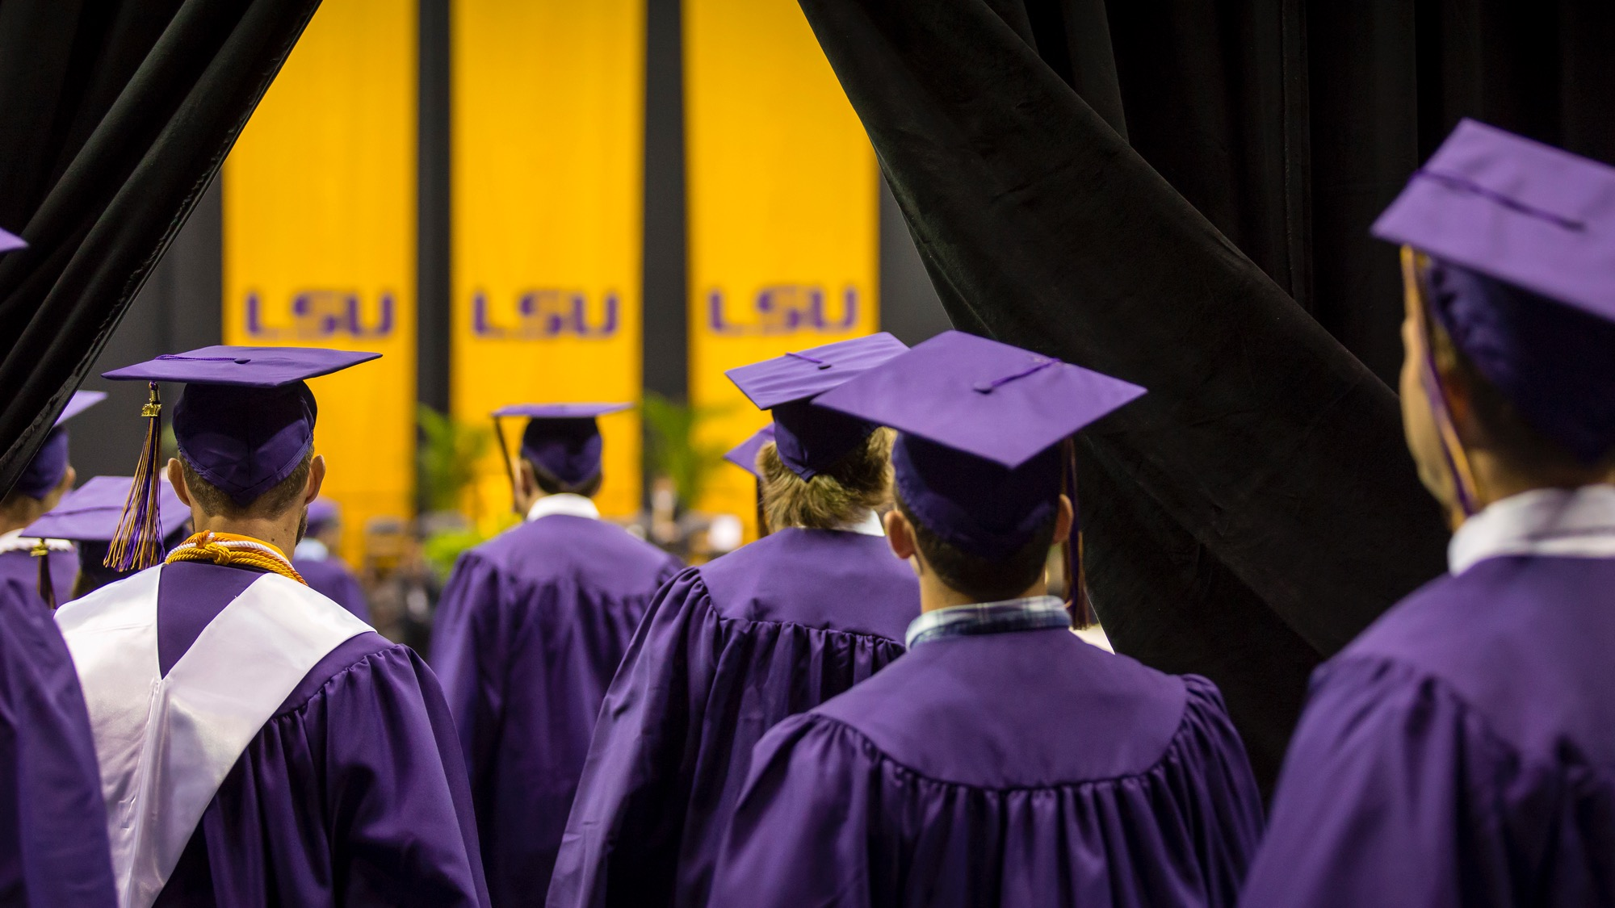
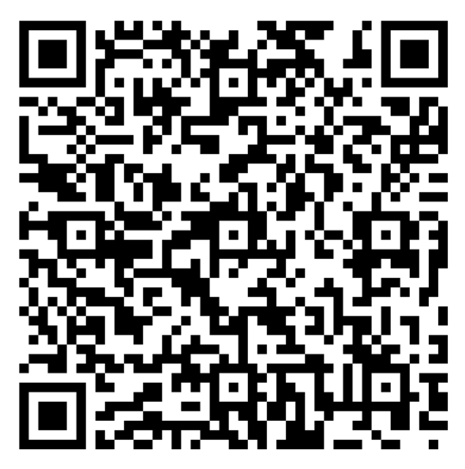
Generative AI Course Acknowledgment

Slide 8

QUESTIONS?

